Slide 1
PROJECT:8SMART WATER FOUNTAIN
IOT PHASE4
DEVELOPMENT PART 2
Hardware Components:
List and description of the hardware components used in the project (e.g., microcontroller, water
pump, sensors).
Schematics and circuit diagrams.
Software Components:
Description of the software components used (e.g., Arduino code, MIT App Inventor).
Detailed explanation of the functionality of the software.
System Architecture:
Explanation of how the hardware and software components work together.

Slide 2
System Architecture:
Explanation of how the hardware and software components work together.
Flowcharts or diagrams illustrating the system architecture.
Implementation:
Step-by-step description of the implementation process.
Any challenges faced and how they were overcome.
Mobile App Development:
Details of the MIT App Inventor project.
Description of the app's user interface and features.
Explanation of how the app communicates with the hardware.
Hardware Control:
In-depth explanation of the Arduino code.How the microcontroller controls the water pump and
interacts with sensors.

Slide 3
Testing and Results
Information about the testing process.
Presentation of results, including the system's performance and reliability.
Conclusion:
Summary of the project's achievements.
Insights gained from the project.
Future Improvements:
Suggestions for future enhancements or modifications.
Ideas for expanding the project's capabilities.
Acknowledgments:
Recognition of individuals, organizations, or resources that contributed to the project's success.

Slide 4
Future Improvements:
Suggestions for future enhancements or modifications.
Ideas for expanding the project's capabilities.
Acknowledgments:
Recognition of individuals, organizations, or resources that contributed to the project's success.
References:
List of sources, code libraries, and references used in the project.
Appendices:
Supplementary materials such as code snippets, detailed schematics, and user manuals.

Slide 5
Key Points to Address:
Detailed Technical Information: Provide a comprehensive understanding of the hardware
and software components and how they interact.
Troubleshooting and Challenges: Discuss any issues encountered during the project and
how they were resolved.
Testing: Describe the methodology for testing the system and the results obtained.
Lessons Learned: Share insights and knowledge gained during the project.
Suggest possible improvements or extensions to the project.

Slide 6
CODE FOR PYTHON
// Include the required libraries
#include <Arduino.h>
// Define the pin connected to the relay
const int relayPin = 2; // Change this to the actual pin you're using
void setup() {
// Initialize the relay pin as an output
pinMode(relayPin, OUTPUT);
// Start serial communication for debugging (optional)
Serial.begin(9600);
}
void loop() {

Slide 7
// Read commands from the serial port (sent by MIT App Inventor or other methods)
if (Serial.available() > 0) {
char command = Serial.read();
if (command == '1') {
// Turn the water pump on
digitalWrite(relayPin, HIGH);
Serial.println("Pump is ON");
} else if (command == '0') {
// Turn the water pump off
digitalWrite(relayPin, LOW);
Serial.println("Pump is OFF");
}
}
}

Slide 8
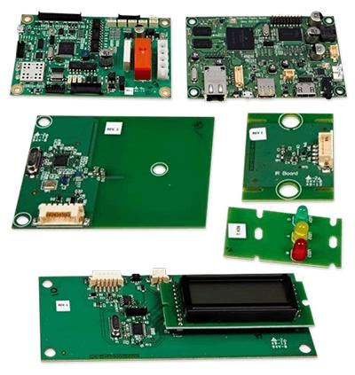

Slide 9
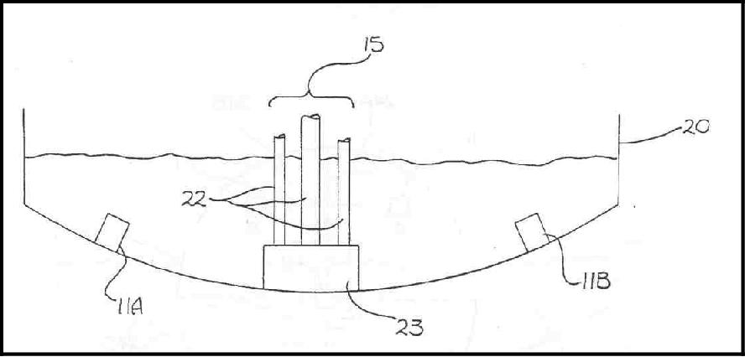

Slide 10
Display unit:
Screen:
The screen will be used to display the readings from the sensors in a real-time manner.[10]
In addition, other necessary information will also be displayed. As described in the sensor
part, the water quality and remaining water quantity will be displayed. The screen will be
programmed so that it makes it easy for users to read information.
This 20*4 LCD display screen is going to be used to display the relevant information. After
programming the screen, a conclusion of water quality(Good, Average, Poor) will be
displayed along with the remaining water level.

